Slide 1
How to be protected of the DDos in AWS
By Vitalii Fedorak

Slide 2
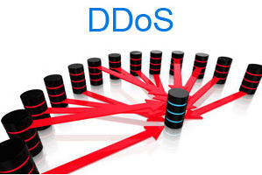
What is DDoS ?

Slide 3
DDos Classification: Attack for infrastructure (Layer 3 & 4 OSI) Attack for infrastructure (layer 6 & 7 OSI)

Slide 4

How to protect yourself in AWS?

Slide 5
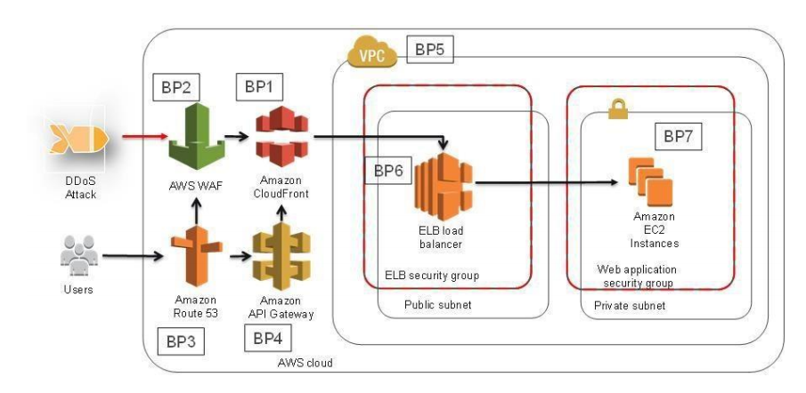
DDoS-resilient Reference Architecture

Slide 6
(BP 7) Instance Size & Choice of Region a) the vertical and horizontal scaling; b) 25 Gbit network interfaces, or Enhanced networking; c) choose the regions;

Slide 7
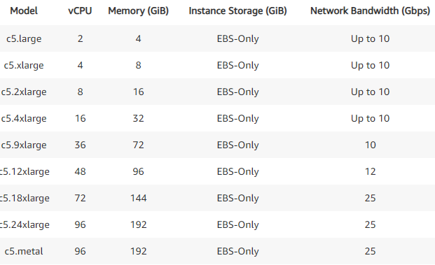
b) 25 Gbit network interfaces, or Enhanced networking;

Slide 8
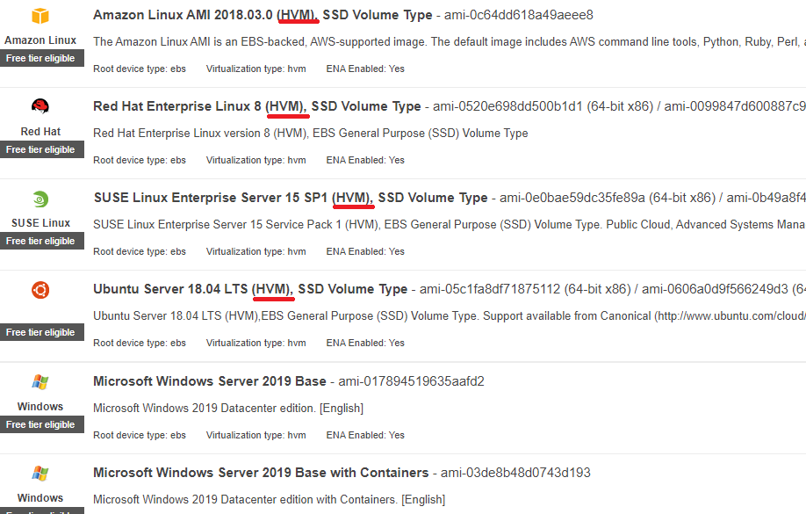
HVM version of Amazon Linux is already enabled enhanced networking

Slide 9
C) Choose the Region Many regions are close to internet exchanges so they have more connectivity to major networks. Being close to exchanges where international carriers and large peers have a strong presence can help give you the internet capacity to mitigate larger attacks.

Slide 10

(BP 6 ) Load Balancing For web applications, you can use ALB to route traffic based on its content and accept only well-formed web requests. For TCP-based applications,you can use NLB to route traffic to Amazon EC2 instances at ultra-low letency

Slide 11
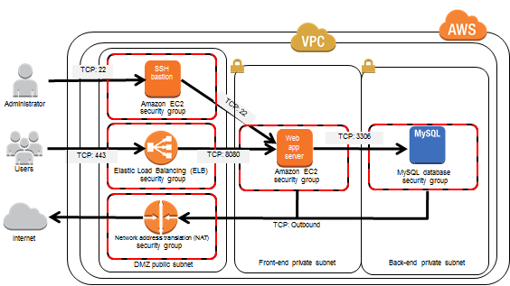
(BP 5) Security Group & Network Access Control Lists

Slide 12
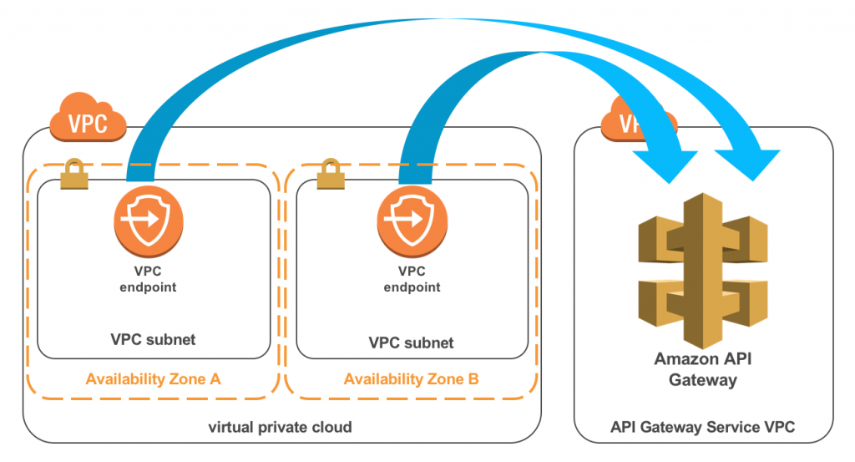
(BP 4) Protecting API Endpoints

Slide 13
(BP3) Route 53 – DNS at the Edge If one name server in the delegation set is unavailable, users can retry and receive a response from another name server at a different edge location. Additionally, Route 53 can detect anomalies in the source and volume of DNS queries, and prioritize requests from users that are known to be reliable.

Slide 14
(BP 2) AWS WAF & AWS SHIELD WAF Benefits: 1. Additional protection against web attacks using conditions that you specify 2. Rules that can allow, block, or count web requests that meet or not the specified conditions 3. Rules that you can reuse for multiple web applications 4. Real-time metrics and sampled web requests 5. Automated administration using the AWS WAF API

Slide 15
Additional protection against web attacks using conditions that you specify: - IP addresses that requests originate from - Country that requests originate fom - Values in request headers - Strings that appear in requests, either specific string that match regular expression patterns - Length of equests - Presence of SQL code that is likely to be malicious (SQL-inj) - Presence of script that is likely to be malicious( XSS )

Slide 16
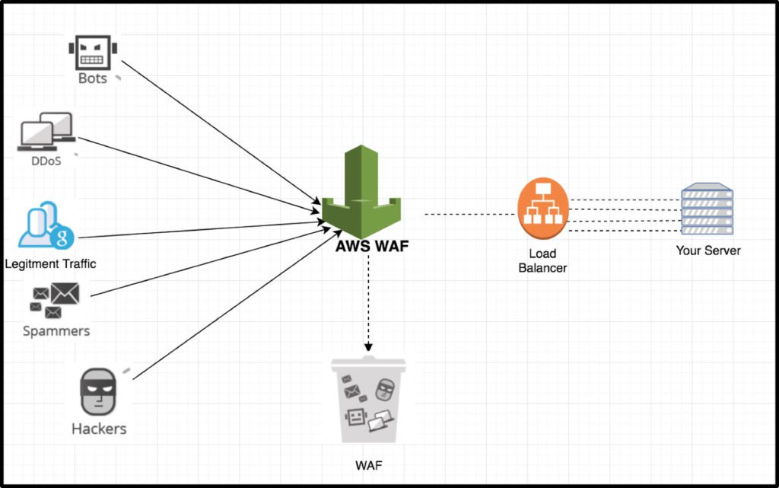
(BP 2) AWS WAF & AWS SHIELD

Slide 17
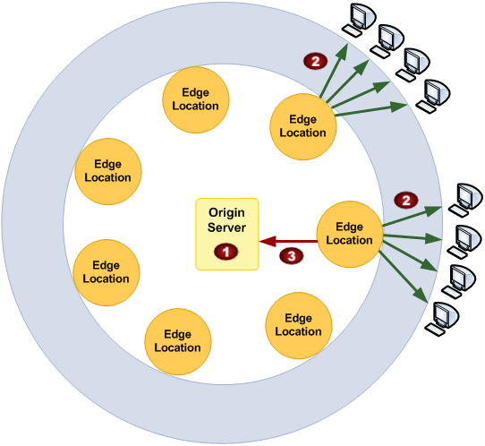
(BP1) CloudFront:

Slide 18
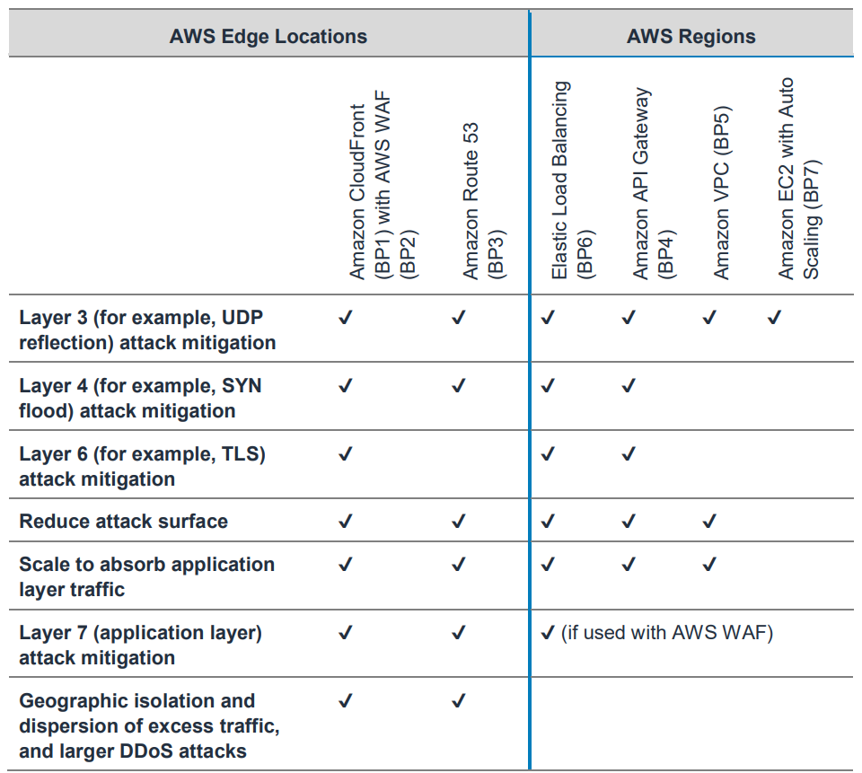
Summary of Best practices

Slide 19
AWS Best Practices for DDoS Resiliency (2019) https://d1.awsstatic.com/whitepapers/Security/DDoS_White_Paper.pdf

